Slide 1
NeuroML
http://www.neuroml.org
NeuroML is a language for expressing models in computational neuroscience in a simulator independent, standardised format. It can express models from integrate and fire cells to complex networks of multicompartmental neurons.
Neuroinformatics tutorial
1.5 Model sharing
Notes:
1

Slide 2
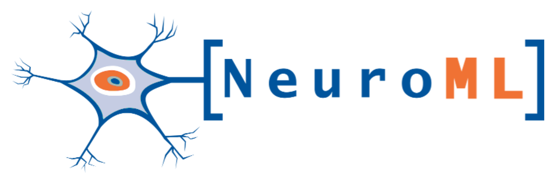
Simulators
NEURON
GENESIS
MOOSE
Brian
Standardised XML language for computational neuroscience
Version 1.x allowed specification of:
- Detailed neuronal morphologies
- Ion channels
- Synapses
- 3D network structure
Version 2 in active development
- Greater range of models
- Easier to extend
30+ simulators/applications/ databases/libraries support NeuroML
Interoperability
PyNN
neuroConstruct
Initiatives
OpenWorm
Open Source Brain
Databases
Channelpedia
BBP NMC
NeuroMorpho
Allen Institute Cell Types DB
Morphological analysis/ generation
Cx3D
TREES Toolbox
NeuGen
Notes:
2

Slide 3
Notes:
3

Slide 4
Notes:
4

